Slide 1

University of Central Florida COP 3330 Object Oriented Programming

Slide 2
Agenda
Input/Output

Slide 3
Basic Input / Output

Slide 4
Byte Streams
Programs use byte streams to perform input and output of 8-bit bytes
All byte stream classes are descended from classes InputStream and OutputStream
Always close streams when it's no longer needed is very important
Close streams in a finally block to guarantee that both streams will be closed even if an error occurs
helps avoid serious resource leaks
A possible error is that a file cannot be opened
When that happens, the stream variable corresponding to the file never changes from its initial null value
Make sure that each stream variable contains an object reference before invoking close

Slide 5
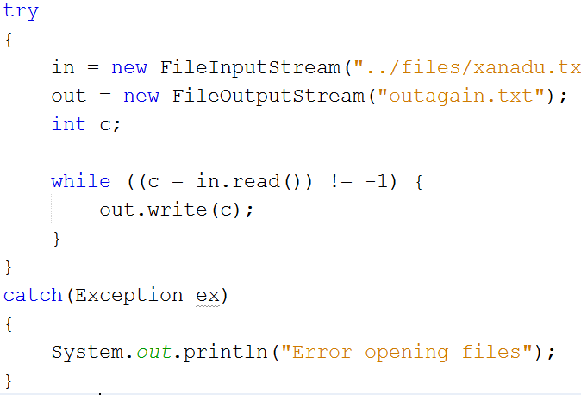
Byte Streams

Slide 6
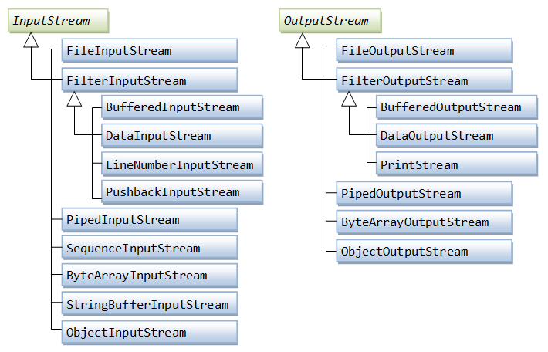
Byte-based Stream

Slide 7
Character Streams
Java platform stores character values using Unicode conventions
Character stream I/O automatically translates this internal format to and from the local character set, usually an 8-bit superset of ASCII
A program that uses character streams in place of byte streams automatically adapts to the local character set
All character stream classes are descended from classes Reader and Writer

Slide 8
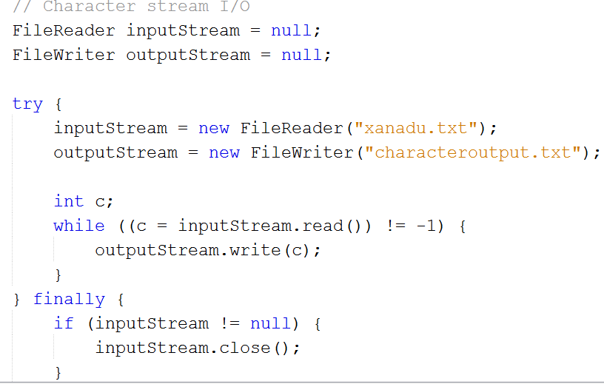
Character Streams

Slide 9
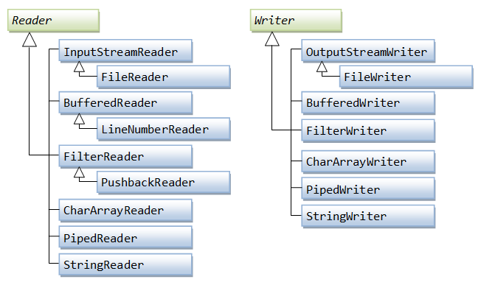
Character-based Stream

Slide 10
Line-based I/O
Character I/O usually occurs in bigger units than single characters
One common unit is the line (i.e. a string of characters with a line terminator at the end)
A line terminator can be
carriage-return/line-feed sequence ("\r\n")
a single carriage-return ("\r")
a single line-feed ("\n")
Supporting all possible line terminators allows programs to read text files created on any of the widely used operating systems

Slide 11
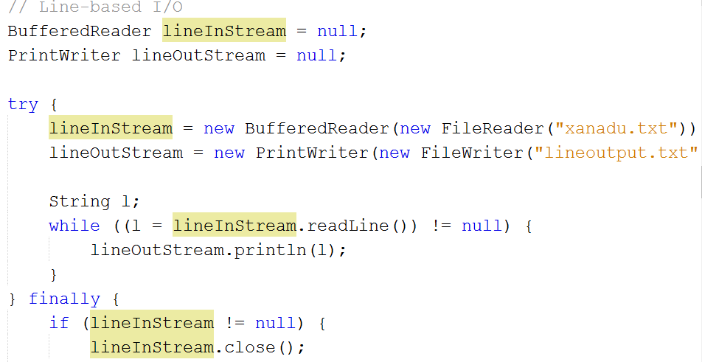
Line-based I/O

Slide 12
Buffered Streams
Examples so far use unbuffered I/O, each read or write request is handled directly by the underlying OS
Can result in a program being much less efficient
Each such request often triggers disk access, network activity, or some other operation that is relatively expensiv
Java platform implements buffered I/O streams
Buffered input streams read data from a memory area known as a buffer
Buffered output streams write data to a buffer
inputStream = new BufferedReader(new FileReader("xanadu.txt"));
outputStream = new BufferedWriter(new FileWriter("characteroutput.txt"));
Four buffered stream classes used to wrap unbuffered streams:
BufferedInputStream and BufferedOutputStream create buffered byte streams
BufferedReader and BufferedWriter create buffered character streams

Slide 13
Buffered Streams
Flushing Buffered Streams
Write out a buffer at critical points, without waiting for it to fill, known as flushing the buffer
Some buffered output classes support autoflush, specified by an optional constructor argument
When autoflush is enabled, certain key events cause the buffer to be flushed
To flush a stream manually, invoke its flush method

Slide 14
Scanning
Objects of type Scanner are useful for breaking down formatted input into tokens and translating individual tokens according to their data type
By default, a scanner uses white space to separate tokens
Even though a scanner is not a stream, close it to indicate being done with its underlying stream
To use a different token separator, invoke useDelimiter(), specifying a regular expression

Slide 15
Scanning
All input tokens treated as simple String values
Scanner also supports tokens for
primitive types (except for char)
BigInteger
BigDecimal
Numeric values can use thousands separators therefore in US locale, Scanner correctly reads the string "32,767" as representing an integer value.
Locale is an issue because thousands separators and decimal symbols are locale specific
Not all scanning would work correctly in all locales without specifying scanner should use the US locale

Slide 16
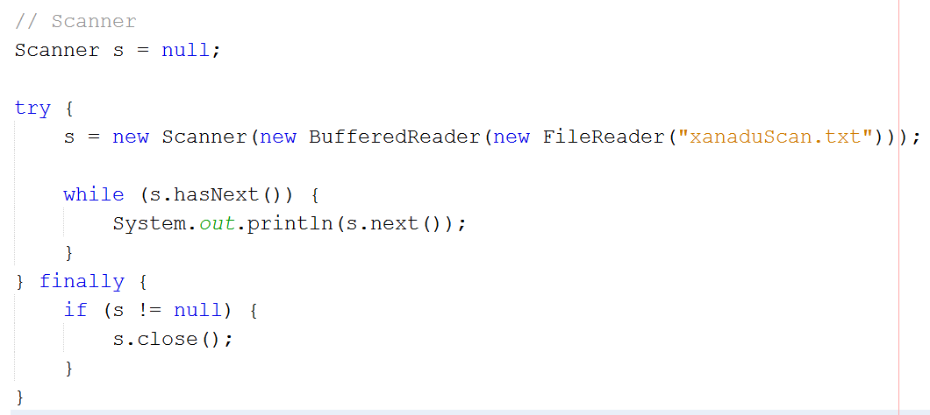
Scanning

Slide 17
Formatting
Stream objects that implement formatting are instances of
PrintWriter ,a character stream class,
PrintStream, a byte stream class, most common classes used
System.out
System.err
print and println
format individual values in a standard way
outputs a single value after converting the value using the appropriate toString method
format formats almost any number of values based on a format string, with options for precise formatting

Slide 18
Formatting
The format method formats multiple arguments based on a format string
The format string consists of static text embedded with format specifiers
d formats an integer value as a decimal value.
f formats a floating point value as a decimal value.
n outputs a platform-specific line terminator.
x formats an integer as a hexadecimal value.
s formats any value as a string.
tB formats an integer as a locale-specific month name.
There are many conversions, GTS!

Slide 19
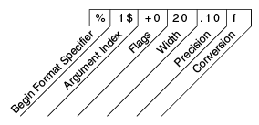
Formatting
A format specifier can contain several additional elements that further customize the formatted output; this uses every possible kind of element

Slide 20
Formatting
Precision. For floating point values, this is the mathematical precision of the formatted value. For s and other general conversions, this is the maximum width of the formatted value; the value is right-truncated if necessary.
Width. The minimum width of the formatted value; the value is padded if necessary. By default the value is left-padded with blanks.
Flags specify additional formatting options. In the Format example, the + flag specifies that the number should always be formatted with a sign, and the 0 flag specifies that 0 is the padding character. Other flags include - (pad on the right) and , (format number with locale-specific thousands separators). Note that some flags cannot be used with certain other flags or with certain conversions.
The Argument Index allows you to explicitly match a designated argument. You can also specify < to match the same argument as the previous specifier.

Slide 21
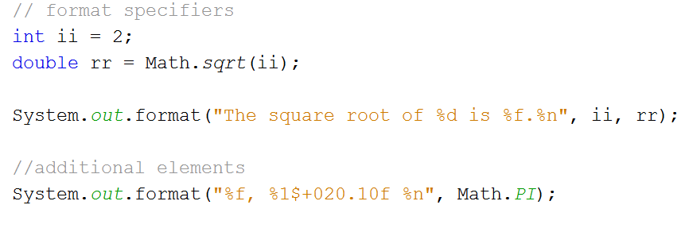
Formatting

Slide 22
File Input / Output

Slide 23
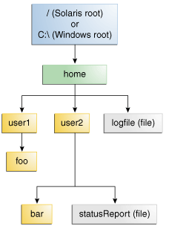
Files and Streams
A file system stores and organizes files on some form of media in a retrievable manner
Most file systems store the files in a tree (or hierarchical) structure with a root node at the top with there are files and directories (folders)

Slide 24
Files and Streams
A path is relative or absolute
Absolute path always contains the root element and the complete directory list required to locate the file
/home/sally/statusReport
Relative path needs to be combined with another path in order to access a file
joe/foo is a relative path
Why files?
Variables and arrays data storage is temporary
For persistent data maintain in files or databases
Files are a sequential stream of bytes
Every operating system has some methodology for identifying end of a file
end-of-file marker
Total byte count

Slide 25
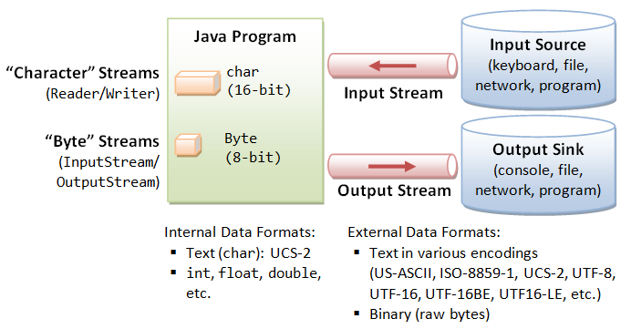
Standard I/O Using java.io Package

Slide 26
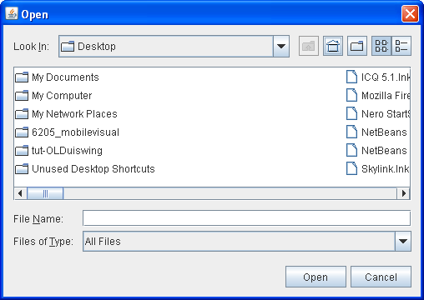
JFileChooser
Displays dialog to allow the user to select a file or directory

